Slide 1

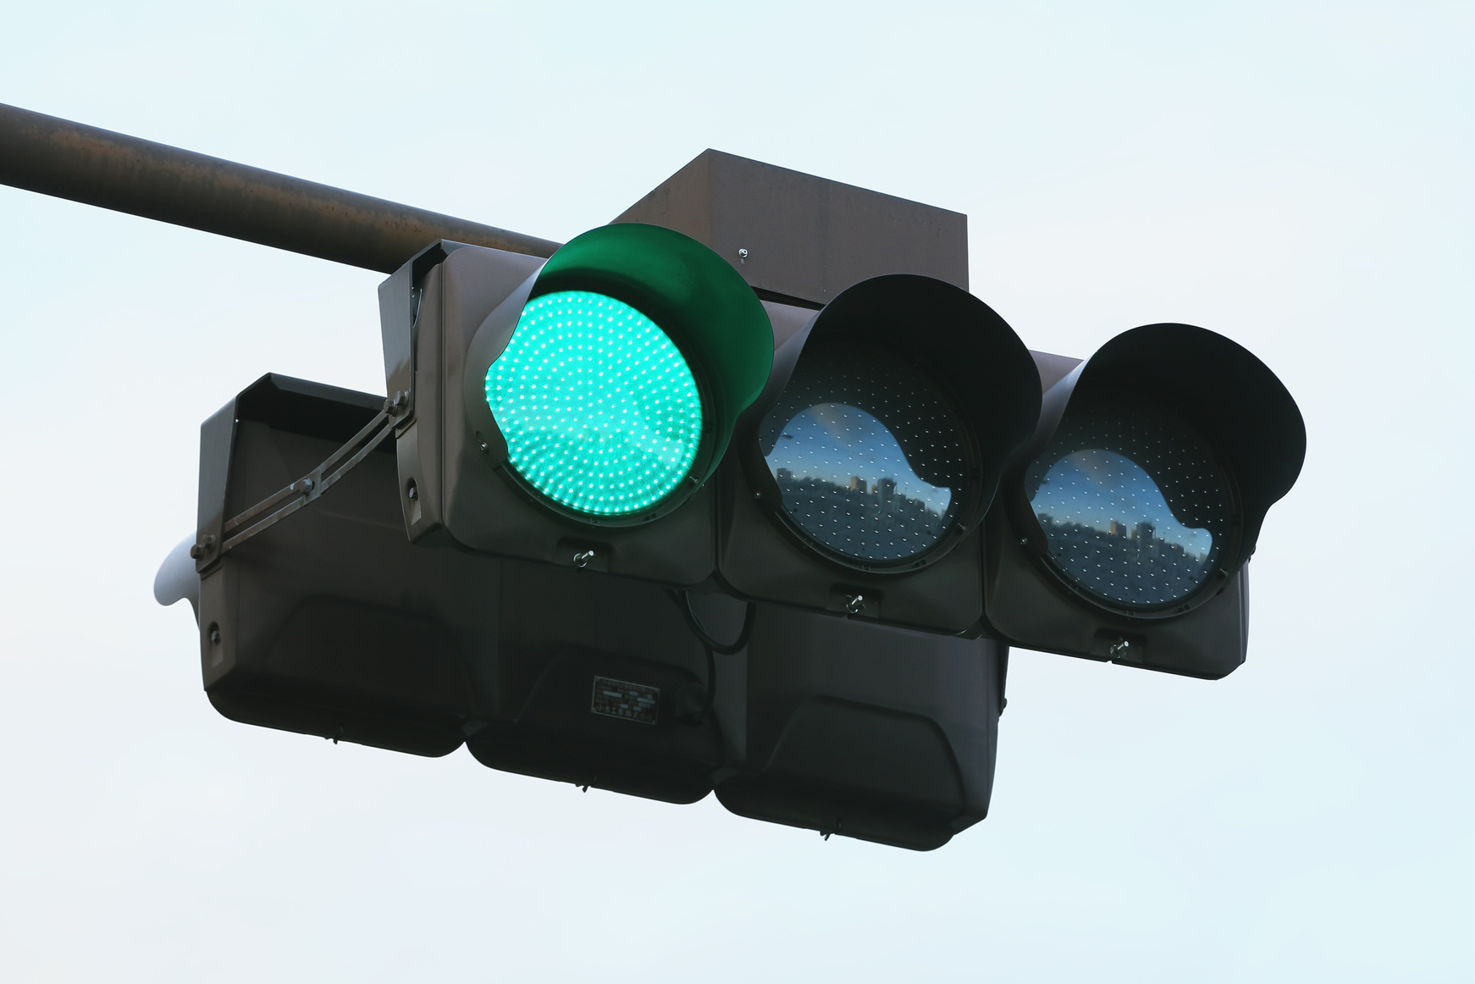
THEME:
CHALLENGE:
Smart Transportation
Adaptive & Responsive Traffic Signal Control
Task Scheduling
JOURNAL: IEEE CLOUD SUMMIT 2024
Using RL and Fog Computing

Slide 2
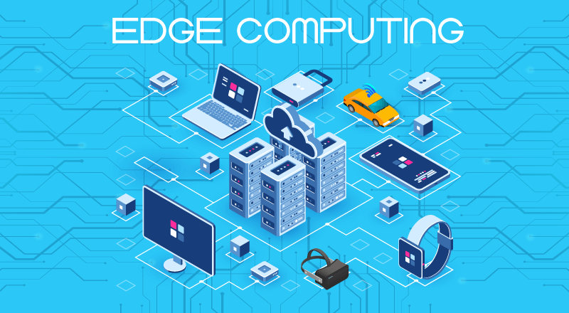
WHY EDGE?
Ultra-low Latency
Bandwidth Savings
System Reliability
Scalable Decisions:
Key Use Cases
1. Urban Traffic Optimization in Cologne, Germany
Use Case: Adaptive traffic light control in Cologne using real-world data to reduce waiting time..
2. Industrial Zones or Smart Campus Control
Use Case: Manage entry/exit traffic during shift changes in an IT park using fog-based control.
3. Vehicle-to-Infrastructure (V2I) Integration (Future Use Case)
Use Case: Use real-time vehicle speed and route data to adjust signals dynamically in smart highways.

Slide 3

PROBLEM STATEMENT
Current DRL-based traffic control approaches face key limitations. Fully distributed systems lead to high communication overhead and network complexity, while centralized cloud solutions introduce latency that fails to meet real-time response requirements. The challenge is to develop a regionally coordinated DRL framework that minimizes congestion while maintaining low latency and system scalability.
Problem Understanding: Justification
Fixed-Time Control: Lacks adaptability to real-time traffic, causing inefficient signal timing.
Distributed DRL: High communication and complexity due to one agent per intersection.
Cloud-Based Control: Network delays make it unfit for real-time traffic management.

Slide 4
PPO ALGORITHM
Role:
Central RL algorithm at fog nodes; coordinates signal phases across intersections in real-time.
How PPO Works:
Policy & Value Networks:
Policy network selects actions (e.g., keep/switch/skip phase).
Value network estimates expected rewards.
Shared Feature Extraction:
Extracts key traffic features (vehicle count, phase, time).
Continuous Learning:
Trains by interacting with simulated traffic (e.g., SUMO), using observed states, actions, and rewards.
Why PPO?
Stable Updates:
"Proximal" step prevents large policy changes—ensures training stability.
Sample Efficient:
Supports multiple learning steps per data batch.
Highly Scalable:
Factorizes actions + action masking for large intersection clusters.

Slide 5
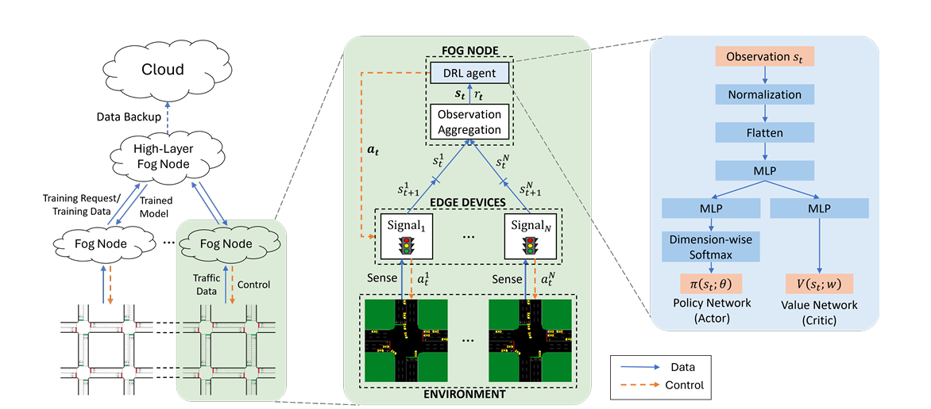
FOG-LIGHT FRAMEWORK

Slide 6


STATE OF ART
Key Themes in Recent Literature:
ADVANCED MULTI-AGENT RL(MARL):
Focuses on improving cooperation between agents.
HIERARCHIAL ARCHITECTURES:
Using fog and cloud layers is a common strategy to achieve scalable and responsive control.
STANDARDIZED BENCHMARKING:
Ensures fair and verifiable
comparisons between different models.

Slide 7

Related Works
MPLight(2020):
A key scalable baseline using "pressure" for decentralized
control.
RegionSTLight (2024):
Dynamically groups intersections into regions to improve
cooperation, a concept similar to our "clustering."
HiLight (2025):
A formal hierarchical framework with high-level “Meta-Policies”
for regional goals and low-level "Sub-Policies" for
individual intersection control.
RESCO (2021):
A framework used to implement and validate baseline
models, ensuring fair comparison.

Slide 8
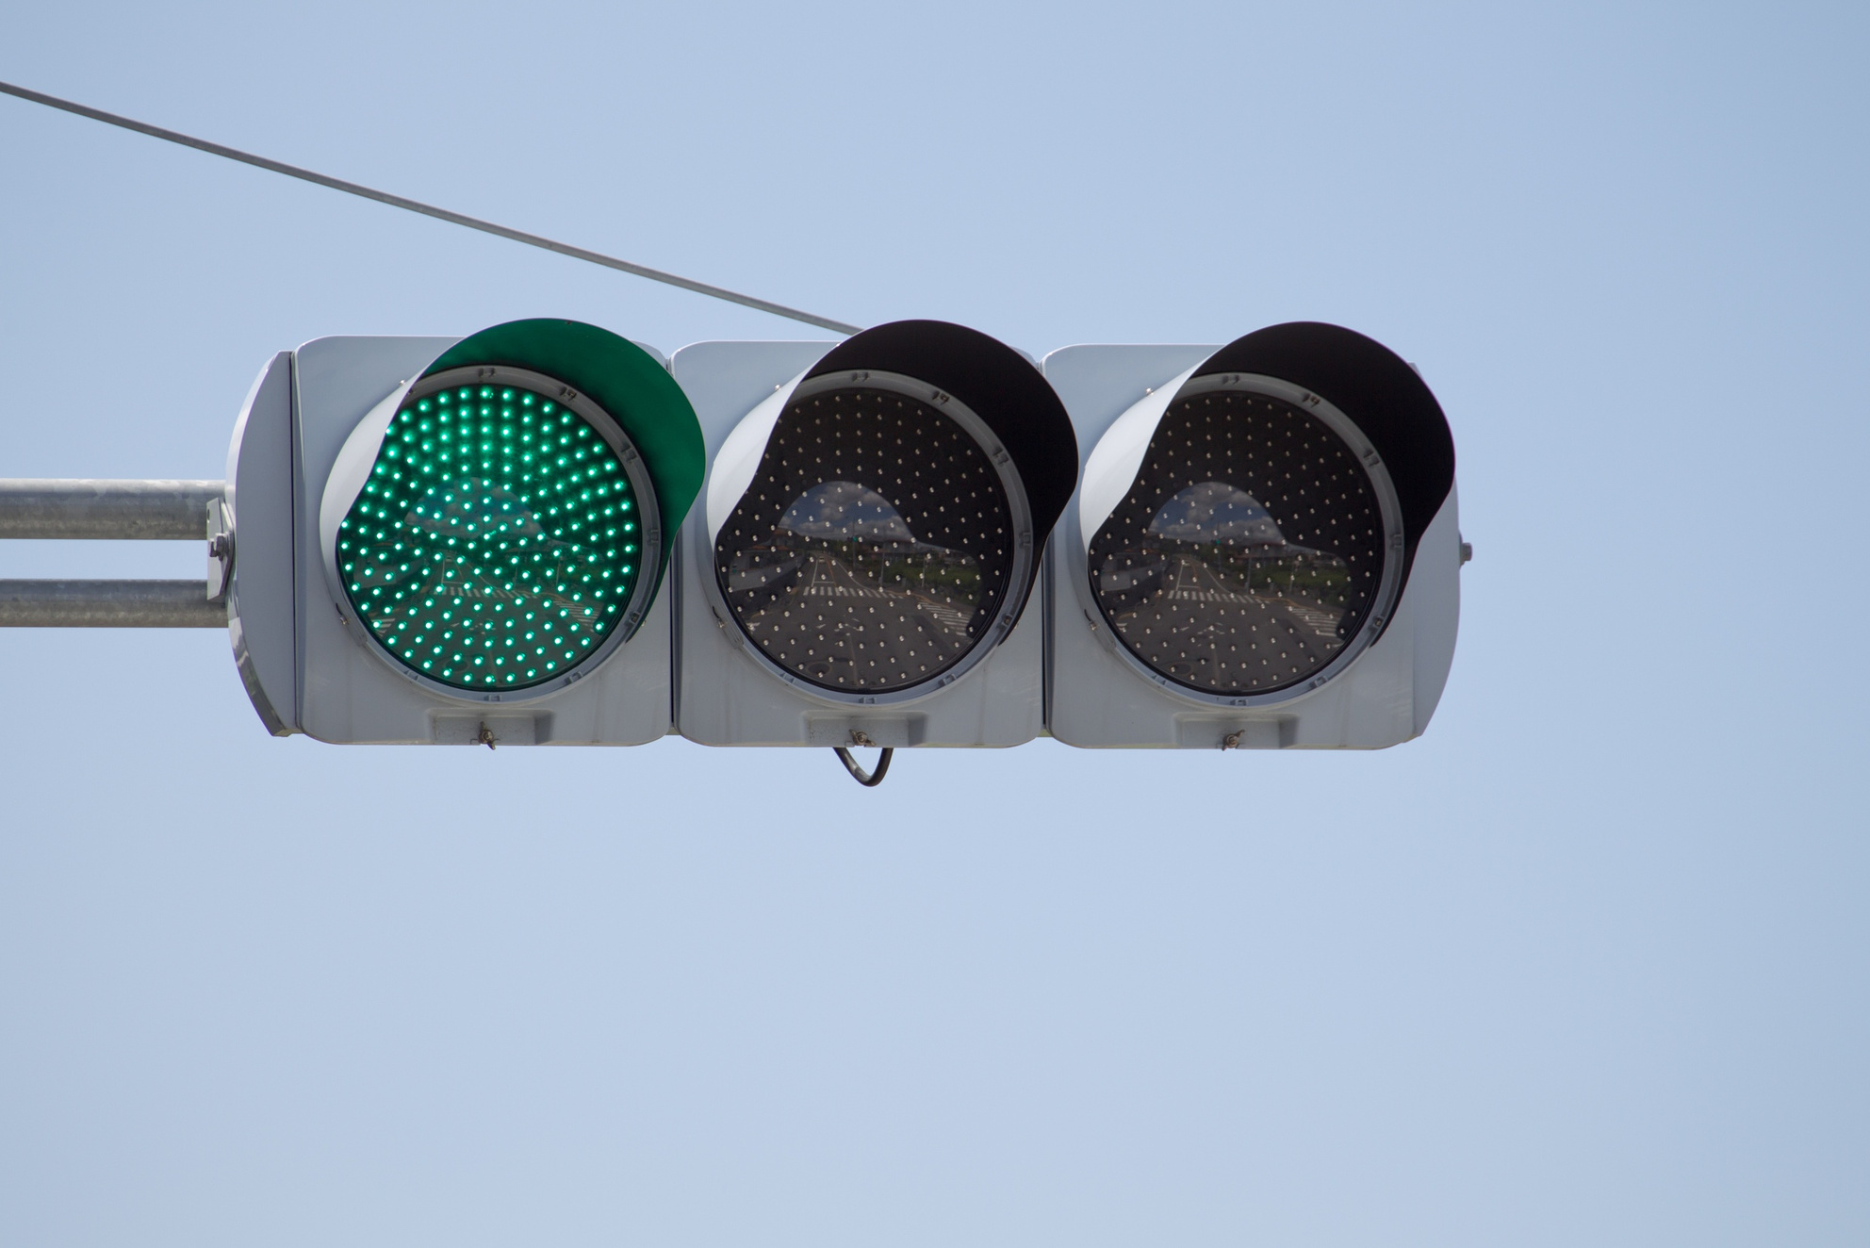
Implementation Strategy
Use Fog Nodes for Local Control
Divide the Traffic Network into Clusters
Group multiple intersections into Clusters
Deploy a shared DRL agent at each fog node to control all signals in its cluster.
Deploy Edge Devices at Intersections
Train Using Proximal Policy Optimization (PPO)
Install edge devices at each traffic light to collect data
Use PPO with separate policy and value networks.

Slide 9
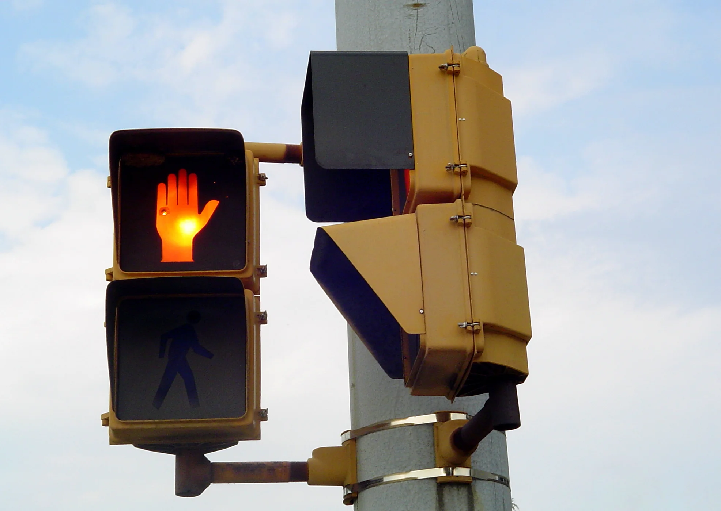
Define the RL Setup for Traffic Signal Control
Strategy:
Observation: Number of vehicles, signal phase, elapsed time
Action: Hold, switch, or skip phase
Reward: Penalize waiting vehicles, emergency braking, and teleporting
Handle Dynamic Road Changes via Retraining or Offloading
Simulate and Evaluate
Use SUMO to simulate traffic in:
Synthetic networks (5, 9, and 18 intersections)
Real-world Cologne road network
If fog node has resources → retrain locally.
Else → offload training to higher (cloud) layer.

Slide 10

TASK SPLIT
HASINI
HARINI
Fog Node & Signal Control
Reinforcement Learning
Create edge devices for intersections
Build fog node to control signal clusters
Handle road changes (add/remove signals)
Simulate retraining requests
Run traffic control logic without and with PPO
Define state, action, and reward
Build and train the PPO model
Use SUMO to test the RL agent
Tune and save the trained model
Compare RL results with baseline methods
JAHNAVI
GHEETHI
Simulation Setup & Baseline Comparison
Complete Evaluation & Visualization
Set up SUMO with both synthetic and real maps
Implement and run FTC and Max-Pressure methods
Collect results like waiting time
Plot and save data
Focus only on non-RL traffic control
Collect data from all 3 others (baseline, fog-only, PPO)
Plot graphs: Avg waiting time, time loss
Compare all methods (FTC, Max-Pressure, PPO, etc.)
Build dashboard/plots using matplotlib/seaborn

Slide 11

THANK YOU
TIME FOR
QUESTIONS

